Slide 1

Codeacademy Project
Learn SQL from scratch
Warby Parker
Joe Allcock |20.06.2019

Slide 2
Table of Contents
Getting Familiar with Warby Parker’s Survey
Analysing the Survey Answer Funnel
Analysing the Quiz to Home try on to Purchase funnel
Assessing the columns in the survey table, analysing the columns and deciding where to draw data from.
Drawing on the data from the survey table and generating a funnel showing completed and incomplete questions.
Combining three tables in order to create an overall funnel for Warby Parker. Analysing the 3 & 5 pair test whilst also generating conversion rates which Warby Parker can act on

Slide 3
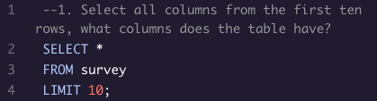
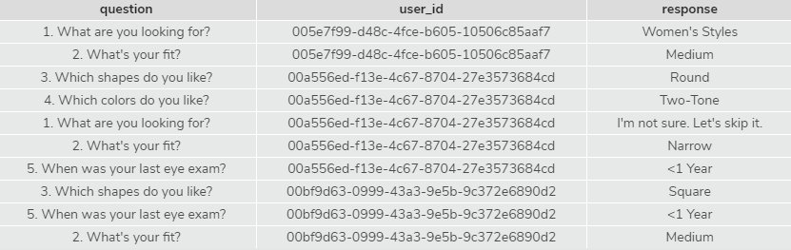
Getting Familiar with the Survey
Getting familiar with any table is vital for generating the right insights and obtaining the right information.
For Warby Parker I had no previous knowledge of the survey that they send to their customers.
Using the Query to the right allowed me to view the columns and different questions that they ask.
A short SELECT statement with a LIMIT on it was required as the dataset was quite large and would’ve taken a long time to load given that I just wanted to see the column names.
The columns from the survey table are question, user_id & response.

Slide 4
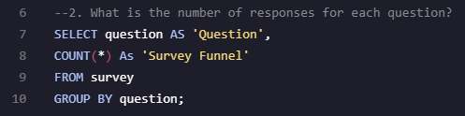
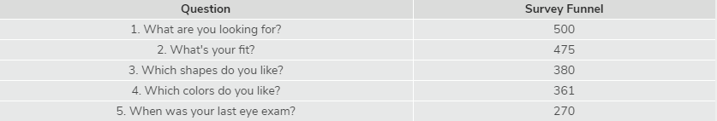
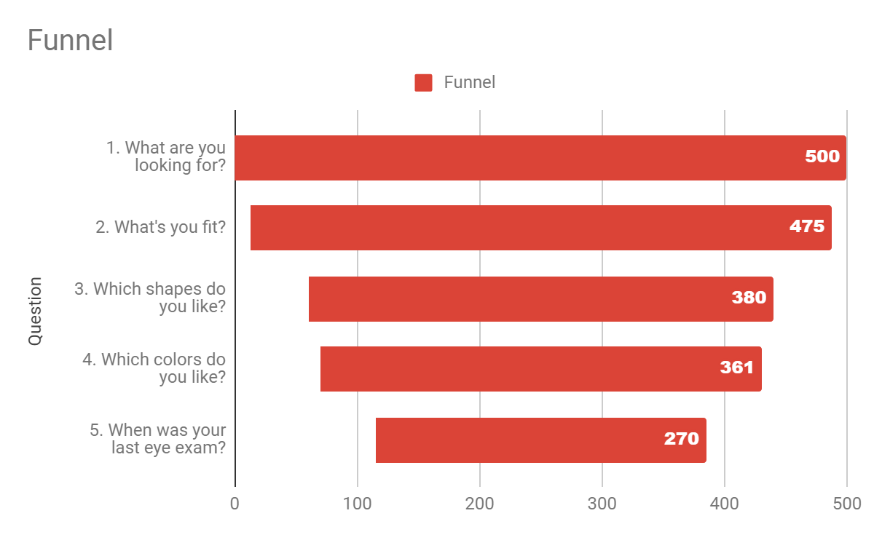
Analysing the quiz answer funnel
Warby Parker wanted to assess their quiz funnel to measure the amount of people who answer the first question in comparison to the last.
To do this I needed to write a query that would return the amount of responses for each answer.
In order to assess the amount of people that answered each question or the ‘give up’ rate I needed to use a COUNT statement grouped by each question.
RESULTS
The results to the right show that there is a tendency for customers to give up. Almost half of those who answered the first question don’t end up answering the last.

Slide 5
Funnel Percentages
These results generated in an excel sheet emphasise the point that I made in the previous slide.
INSIGHTS
The give up rate is low (5%) from question 1 to 2 and it seems once someone has got to question 3 they are likely to answer question 4 with number of responses only dropping by 3.8%.
46% of people who answer the first question don’t answer the last.
ACTIONS
There is an action for Warby Parker to add an aspect to the quiz to keep customers engaged so that they answer all of the questions.
They could potentially test different ways of doing this via A/B testing to see which action has the largest effect on the above percentages.
Question | Quiz Funnel | Percentage
1. What are you looking for? | 500 | 100.00%
2. What's your fit? | 475 | 95.00%
3. Which shapes do you like? | 380 | 76.00%
4. Which colors do you like? | 361 | 72.20%
5. When was your last eye exam? | 270 | 54.00%

Slide 6
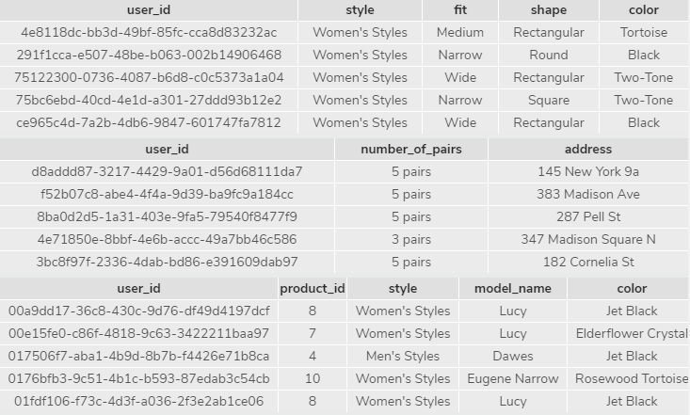
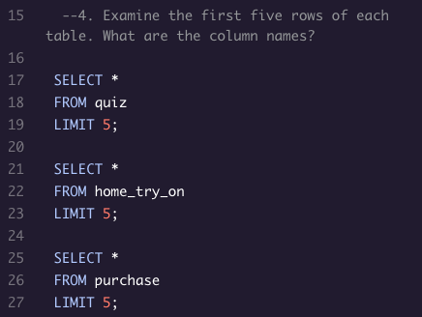
Getting familiar with new tables
I now needed to get familiar with 3 new tables in order to generate a new funnel.
Calling all the columns from each of the 3 tables; quiz, home_try_on and purchase would allow me to assess which column would be suited to performing a LEFT JOIN on.
All tables have the column user_id, so it would be simple enough to perform a LEFT JOIN using the user_id as a key.

Slide 7
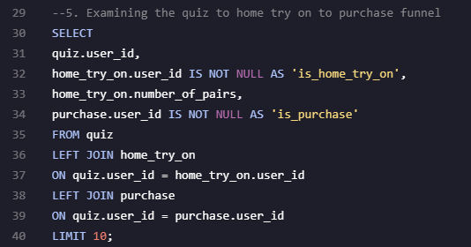
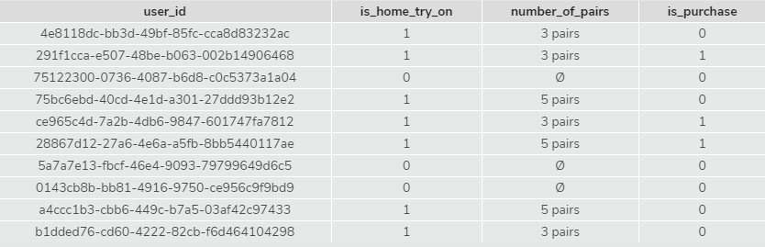
Analysing the Quiz to Home try on to Purchase funnel
In order for Warby Parker to gain insights into how many people went from Quiz to Home Try on to Purchase I needed to create a table which I could draw conversion rates from.
Performing a LEFT JOIN on all three tables and creating columns which returned BOOLEANS (1 or 0) by using IS NOT NULL allows Warby to assess which user_ids went through to home try on and purchase.
This Query can now be used in WITH statements to gather information on conversion rates and the overall funnel of the company, as well as the results of their 3 and 5 pair test.
I will generate some of these insights on the next 3 slides.

Slide 8
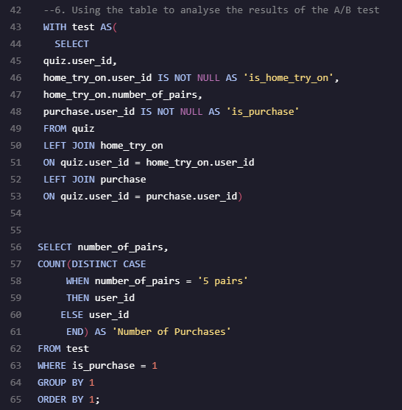
Purchase Rate Difference – 3 pairs vs 5 pairs
The first actionable insight that I was able to draw from the table generated in the previous slide was the results of the A/B test that Warby Parker constructed.
METHOD
Using a WITH statement I created a temporary table called test which used the query from the previous slide. I then wanted to count the number of users with 5 pairs and 3 pairs who had purchased a pair of glasses. I was able to do this by combining a COUNT, DISTINCT and CASE statement using WHERE to only count the user_ids where the associated is_purchase statement is true (equal to 1).
I then made sure to GROUP BY the number_of_pairs column and this generated the results to the right.
RESULTS
- 93 more customers who tried on 5 pairs bought a pair of glasses in comparison to those who tried on 3 pairs.
These results mean that in future, to improve conversion rates, it might be worth providing more pairs to try on at the home try on stage.

Slide 9
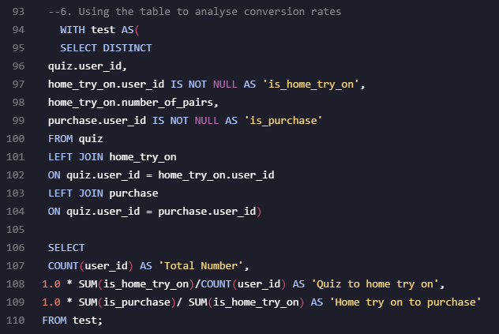
The Funnel &Conversion Rates
METHOD
Using the same table again, I could also generate the conversion rate from each stage of the customer journey.
As the results in the is_home_try_on and is_purchase columns are BOOLEANS (1 or 0), I could SUM these results from the test table and gather conversion rates based on these SUMs.
The SELECT statement below the WITH statement allowed me to gather these conversion rates. I initially counted the amount of users at each stage, essentially the funnel, to give a high level view of the number of customers Warby Parker has at each stage. I then used the SUM statements to create conversion rates at each stage, ensuring that each calculation was multiplied by 1.0 to generate a FLOAT, otherwise it would’ve been rounded to 1 or 0 as an integer.
RESULTS
There is a conversion of 75% from quiz to home try on which is a good amount.
But of those who got to the home try on stage only 66% purchased a pair of glasses.
This means that potentially more should be done at the home try on stage to ensure the conversion rate remains as high as the quiz to home try on rate.

Slide 10
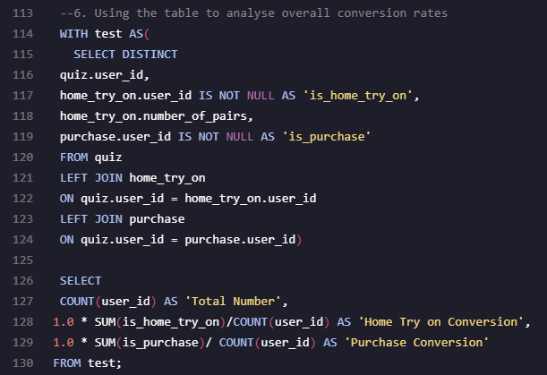
Overall Conversion Rates
Using almost the same query as on the previous slide, Warby Parker can gain insights into their overall conversion rate.
This is done by dividing the is_purchase SUM by the COUNT of the user_ids.
RESULTS
This shows an overall conversion rate of almost 50% from quiz to purchase, which is quite a good rate of conversion to build on.
In order to increase conversion, Warby Parker may want to test, in more detail, the 3 pair to 5 pair hypothesis. If providing 5 pairs to customers at the home try on stage continues to have a significant impact on that conversion then they should definitely think about rolling it out for all customers.
Once they start rolling it out we can run similar queries testing the difference in conversion between certain dates, i.e. when the change came in. The results will influence decisions regarding the home try on phase going forward.

